Slide 1

© 2008 – IOTA PHI THETA FRATERNITY, INCORPORATED. TM ALL RIGHTS RESERVED.

Slide 2
TRAINING AGENDA
INTRODUCTION & ROOT CAUSE ANALYSIS MODEL
INTAKE CERTIFICATION
TOP 5 PROBLEMS
HISTORY
INTAKE WEBSITE
STRUCTURE OF BROTHERHOOD INTAKE PROGRAM
INTAKE ACTIVITIES (BEFORE, DURING, & AFTER)
RESPONSIBILITIES (BROTHERS & INITIATES)
RISK MANAGEMENT
COMPONENTS
NEGLIGENCE
LIABILITY & CLAIMS
CRISIS MANAGEMENT
COMPONENTS
PROCEDURES
CONCLUSION

Slide 3
Root Cause Analysis Model
Never Knew
Forgot
Task Implied
Scarce Resources
Don’t Know How
Impossibility
No Reward
No Penalty
Disagree?
Notes:
The Root Cause Analysis Model has three major headings: Don't Know, Can't Comply, and Won't Comply. Each heading includes three categories that the trainer can pose as questions. The trainer should start with the heading Don't Know and then ask questions one through three in sequence. For example, under the heading Don't Know, the trainer should ask, "Did the brother or chapter ever know about the requirement?" The information that the trainer gathered from interviews, sensing sessions, observation, and document reviews should lead him or her to a particular answer. The trainer should not stop upon finding an answer to a question. More than one reason may exist for compliance or non-compliance, so the inspector should follow the model all the way through.
a. Don't Know.
(1) Never Knew: Did the person or unit ever know about the requirement? A positive answer to this question usually means that some organization at some echelon failed to get the information down to the required level.
(2) Forgot: Did the person or unit forget about the requirement? A positive answer to this question usually suggests a local -- or personal -- problem and not a systemic problem.
(3) Task Implied: Was the task implied but the unit or person lacked the knowledge or experience to recognize the requirement? In organizations whose members are highly experienced, identifying and accomplishing implied tasks is second nature. But in organizations that suffer from rapid turnover and varying levels of experience, the leadership should compensate by providing more explicit guidance.
b. Can't Comply.
(1) Scarce Resources: Did the person or unit have the resources to accomplish the requirement? Many units often lack the resources to accomplish many of their assigned missions. The scarcest resources tend to be time and money. Part of the problem may be a conscious decision that a leader made concerning priorities. Before an inspector challenges a unit's priorities, the inspector must view and understand the bigger picture. The priorities the leader selected may be the right ones, but that fact does not mean that the inspector cannot question the decision.
(2) Don't Know How: Did the person or unit know how to meet the requirement? A negative response to this question might suggest a lack of training or experience. The resources may be available, but the unit or person simply lacked the knowledge to perform the task -- even if the unit or person knew about the requirement.
(3) Impossibility: Was the requirement impossible for the unit or person to perform? A positive response to this question suggests that training, resources, and knowledge of the requirement were there, but the unit or person found the task impossible to accomplish. A number of potential reasons may surface. Perhaps the task was overly ambitious and incredibly difficult to perform under any circumstances.
c. Won't Comply.
(1) No reward: Would the person or unit be rewarded for completing the requirement? Some people consciously decide not to comply with requirements that do not benefit them or their unit -- or are "dumb" in their estimation. Some people simply avoid difficult tasks. A disciplinary penalty may be involved in decisions of this nature.
(2) No Penalty: Would the person or chapter suffer a penalty by failing to complete the requirement? Some groups or individuals choose not to comply with what they deem to be "unsavory" tasks because no one will punish them for their non-compliance. Some people focus only on what keeps them out of trouble. Once again, a disciplinary penalty may be involved in a decision of this nature.
(3) Disagree: Did the person or unit disagree with the requirement? In some rare instances, individuals refuse to comply with a requirement that they think is "dumb" or "stupid." Sometimes they are correct, and sometimes they are not. Once again, a disciplinary penalty may be involved.

Slide 4
Enforcement vs. Inspection
What procedures are in place to encourage self-monitoring (inspections: proactive measures)?
How is this information used?
What judicial procedures (enforcement: reactive measures) need to be in place?
How often is the Tribunal Process utilized?
How often do we refer to the Code of Conduct?
How often do we refer to the Code of Ethics?

Slide 5
TOP 5 PROBLEMS WITH INTAKE
Following the chain of command!
Chapter Polaris, Chapter Advisor (for Undergraduate Chapters), State Director, ARP, RP, Grand Vice-Polaris, Grand Polaris
Following the rules of both the school and the fraternity!
Higher standard (GPAs, credit hours, definitions of hazing, length of time)
Advise chain of command of conflicts between school policy and fraternal policy
Undergraduate Chapter Advisors not active and financial members of an alumni chapter!
Chapter and Faculty roles may NOT coincide
Undergraduate Chapters without any guidance and oversight from an advisor or alumni chapter are contributors to systemic problems
Not reporting issues in a timely manner!
Bad News Does Not Get Better With Age
Money and intake paperwork after the line starting!
This is why we have a problem with record-keeping
Notes:
Differentiate Protocol between Undergraduate Chapters and Alumni Chapters
Undergrad: Chapter Polaris, Chapter Advisor, Alumni Chapter Polaris, State Director, and so on.
Point 2 – Following the Rules
We should not state that in all cases that the fraternity’s rules are superseded by the university because there are some times that the fraternity’s policies supersedes the university’s (i.e. School GPA Requirement 2.0, Fraternity’s GPA 2.5 – Fraternity’s Standard is the Rule, Fraternity has a more defined Hazing Law than the University).
Before we address point #3, we have Undergraduate Chapters are in existence without any guidance and oversight from an advisor or alumni chapter. In the next level of growth, every chapter must be under some type of guidance.

Slide 6
EVOLUTION OF INTAKE PROCESS
1963: “It Takes A Man”
1970s: “The Pledge Movement”
1980s: “Apex”
1990s - PRESENT: “The Movement to Membership Intake”
1989-1997: “7 Day Process”
1997: “No Less than 2 Weeks / No More than 5 Weeks”
1999: “National Five Week Intake Program”
2003: “National Intake Program v2 (per Chapter Handbook)
2007: Rollout of “Paperless” Intake Process
Notes:
Iota Phi Theta was the first fraternity to implement a membership intake process in the late 80s. From approximately 1989 to 1997, the official membership intake process was seven days (one day related to each principle with a day for going-on ceremony and a day for going-over ceremony). At the 1997 Conclave, a proposal was voted on that stated the intake process would be no less than two weeks but no more than five weeks. At the 1999 Conclave, we voted on a National Five-Week Intake program that set out a daily calendar/structure for each day of process. In the 2003 edition of the Chapter Handbook, we took the position that each week should have targeted objectives, but the layout of the calendar was more specifically left to the discretion of the chapter. In 2007, the national intake website was launched which allowed intake paperwork and funds to be submitted electronically.

Slide 7
Pre-Intake
Getting the best candidates
What chapter programs to we use to attract members?
What is your long term plan for chapter growth?
Recruitment
Informational Session: Introduce the general public to the fraternity
The Interview Process: Interview potential candidates from the informational session using the quality standards worksheet from the chapter handbook
The Formal Smoker: Final meeting prior to intake class starting to confirm that potential members have resources (academic, monetary, etc) needed to start intake process

Slide 8
A Technique – “Informational Session”
Proper attire is a must
Advertise in the right forums (i.e flyers, direct contacts, internet, etc.)
Recommended Agenda: Welcome, Introduction of Brothers and Guests, Presentation of National History (Video/Powerpoint), History of Chapter (or Region if a Colony Activation), Guest Speaker: What Makes Iota Unique, Requirements for Intake, Q&A Session
Way Ahead: Copies of flyers, presentations, and agendas posted to Iota Training Library on secure web (Conclave 2009)

Slide 9
A Technique – “What is Your Chapter’s
Interview Process?”
Use a good quality control metric
(i.e. Quality and Minimum Standards Assessment Worksheet located in chapter handbook)
Get to know your prospective candidates (and their families if possible) before intake
(Invite them to chapter social and community service functions)
Perform “targeted” recruiting
(What skill sets/assets do we need in our chapters)
Way Ahead: Updated national quality & minimum standards assessment worksheet. (Target Date: Conclave 2009)

Slide 10
A Technique – “Interview Guide”
Minimum Standards: (Y-Yes/N-No)
_____ 1. Is the candidate in academic good standing at his college or university? (Undergraduate Candidates Only)
_____ 2. Does the candidate understand and agree to pay on a timely basis all membership dues, fees, and costs; does the candidate understand and agree to all other obligations of the Chapter (participation requirements, etc.)?
_____ 3. Does the candidate have a history of leadership and involvement, which
demonstrates that he will be an asset to IOTA and to his Chapter?
_____ 4. Is the candidate a graduate of a 4 year institution or three years in a professional field? (Alumni Candidates Only)
ALL MUST BE ANSWERED YES

Slide 11
A Technique – “Interview Guide”
Academics: (25 Points)
A. GPA in High School: C. Rank in High School Class:
(5) 4.0 – 3.5 (5) Top 10%
(4) 3.4 – 3.0 (4) Top 20%
(3) 2.9 – 2.6 (3) Top 30%
(2) 2.5 – 2.2 (2) Top 40%
(1) 2.1 – 2.0 (1) Top 50%
Point Total: ________ Point Total: ________
B. SAT or ACT test scores: D. College GPA:
(5) Above 1050 26 – 36 (5) 4.0 – 3.5
(4) 1050 - 950 26 – 25 (4) 3.4 – 3.0
(3) 949 - 850 24 – 22 (3) 2.9 – 2.6
(2) 849 - 700 21 – 19 (2) 2.5 – 2.2
Below 700 0 – 18 (1) 2.1 – 2.0
Point Total: ________ Point Total: ________
E. Does he have potential for academic success? (Yes = 5 Points) Point Total: ________

Slide 12
A Technique – “Interview Guide”
Financial: (25 Points)
Acknowledges requirements and can pay the Membership Fee and Annual Dues (Yes = 25 Points) Point Total: ________
Leadership Involvement: (25 Points)
A. High School and Collegiate Involvement (5 Points Each)
1) Sports 2) Music 3) Academic Teams 4) Student Councils 5) Other Point Total: _______
B. Other Involvement (10 Points Each)
1) Youth Groups 2) Athletic Teams 3) Religious Activities 4) Scouting 5) Other Point Total: _______
Will Chapter Benefit by this Member? (30 Points) (5 Points for each Yes answer)
A. _____ Socially with this Individual fit with the personality of the chapter members?
B. _____ Based upon his background this Individual work as part of a team?
C. _____ Does the Individual bring a skill set that will benefit the Chapter?
D. _____ Does he show interest in other campus organizations?
E. _____ Does this Individual embody the spirit needed to become a good Brother?
F. _____ Is he a legacy?

Slide 13
A Technique – “Interview Guide”
Letters of Recommendation: (30 Points)
A. Brother Letter _________
• An excellent recommendation should get maximum points. A letter from a National Officer, Chapter Polaris or Regional Leader should be weighted heavily. A letter from a non-financial member should be scored low in respect to the Brother not living up to his responsibility. A strong letter from an active member should be weighted accordingly.
B. Other Recommendation_______
• A letter from a Pastor, Director or Mentor should be weighted heavily. A letter from an employer mid-level weighting and a letter from someone with ties not associated with a program or services that has demonstrated leadership or a commitment to service should be lightly weighted.
Total Points ------ 145 Points Total Points: ________
* The candidates must score a minimum of 110 points to be considered for membership
Dispensation:
_____ Candidate qualifies on points for membership
_____ Candidate qualifies by vote of Chapter and Regional Leadership Team
_____ Candidate does not meet the standard necessary for membership at this time

Slide 14
Structure Of Brotherhood
Intake Process
Modular Program: Should be modified to suit school/chapter requirements with approval of the Regional Polaris (or his designee)
Segments: National and Chapter History, Centaur (Community Service Planning), Chapter Development, and Induction
Purpose: Development of well-rounded neophyte brothers in accordance with local laws, school requirements, and fraternity guidelines
Bottom Line: Develop plan for your chapter’s intake process and have it approved by your Regional Polaris (or his designee)
Notes:
If a chapter must have the intake program modified for the university, it shall be submitted from the chapter advisor to the State Director/ARP who shall approve or the denial the modification. The original language states it should be approved by the Regional Polaris. We need to delegate that down because they would be the first line of defense from the region with interactions from the university outside of the chapter advisor

Slide 15
DAY 1: INDUCTION CEREMONY | DAY 2: NATIONAL HISTORY (1963-1975) | DAY 3: NATIONAL HISTORY (1968-1983) | DAY 4: NATIONAL HISTORY (1983-PRESENT) | DAY 5: TEST – NATIONAL HISTORY & SCHOLARSHIP ESSAY PRO SHOW PRACTICE
DAY 6: CHAPTER HISTORY – FOUNDERS | DAY 7: CHAPTER HISTORY I | DAY 8: CHAPTER HISTORY II | DAY 9: INTAKE CLASS PROJECTS | DAY 10: TEST – CHAPTER HISTORY & LEADERSHIP ESSAY PRO SHOW PRACTICE
DAY 11: PRINCIPLES OF A CENTAUR; COMM. SVC.– LEADERSHIP | DAY 12: STEP/SONG CLINIC I, COMM. SVC – SCHOLARSHIP | DAY 13: STEP/SONG CLINIC II, COMM. SVC - CITIZENSHIP | DAY 14: COMM. SVC. - FIDELITY | DAY 15: CENTAUR CEREMONY; COMM. SVC – BROTHERHOOD, CITIZENSHIP ESSAY PRO SHOW PRACTICE
DAY 16: CHAPTER OFFICERS; PARLIAMENTARY PROCEDURE | DAY 17: FINANCIAL READINESS; EVENT PLANNING I | DAY 18: CONDUCTING MEETINGS; EVENT PLANNING II | DAY 19: INTAKE CLASS PROJECTS | DAY 20: CHAPTER DEVELOPMENT TEST; FIDELITY ESSAY PRO SHOW PRACTICE
DAY 21: INTAKE LINE PROJECTS | DAY 22: GRAD CHAPTER SYMPOSIUM I | DAY 23: GRAD CHAPTER SYMPOSIUM II | DAY 24: BROTHERHOOD ESSAY; INTAKE CLASS PROJECTS FINAL PRO SHOW PRACTICE | DAY 25: COMPREHENSIVE FINAL EXAM; GOING-OVER CEREMONY PRO SHOW
Notes:
This is an example calendar.

Slide 16
A Technique –
“Writing Requirements”
See how your initiates communicate and think
Allows for structure when time schedules limit number of sessions
Examples of writing assignments
(Autobiographies, Reasons for Seeking Membership, Analysis of Fraternal Principles, Historical Figures and Symbology, etc.)

Slide 17
A Technique –
“Centaur Week”
Initiates should perform community service as part of intake process
Communicate with chapter or regional community service coordinators for planning ideas
Opportunities to learn fraternal songs and chants

Slide 18
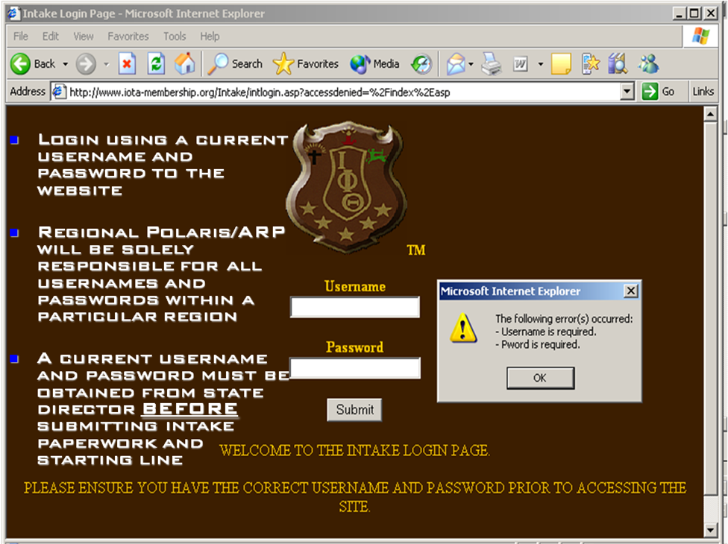
IOTA INTAKE WEBSITE www.iota-membership.org
National System of Record!
Obtain password per semester via State Director
Keep copies/receipts of all submissions!

Slide 19
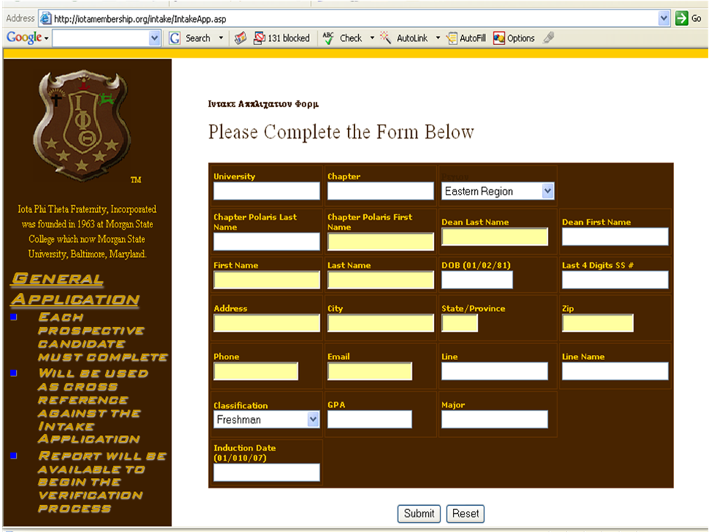
Notes:
Common Problems:
Make sure the pulldown menu selection for region (first row, third column of second page) has the correct Region selected. If it doesn't, your membership materials will be forwarded outside of the Region and likely be lost/mishandled as other Regional Management Teams are not informed of your region's intake programs.
For Phone Number(fourth row, first column of second page) put all numbers, NO DASHES Example:555555555 NOT 555-555-5555.
GPA(sixth row, second column of second page) is a required field (EVEN for Alumni -- this is a tech error with the site that may not be fixed in the immediate future). Fill in a number between 2.5 and 4.0. Undergraduates: Your chapter advisors may be required to forward/verify informal transcripts for all intakees to your State Director prior to starting intake.
For induction date (seventh row, first column of second page) -- DO NOT put in any dashes. Example: April 15, 2008 should be entered as 04152008 not 04/15/08. Again, this is a tech error that may not be fixed in immediate future.

Slide 20
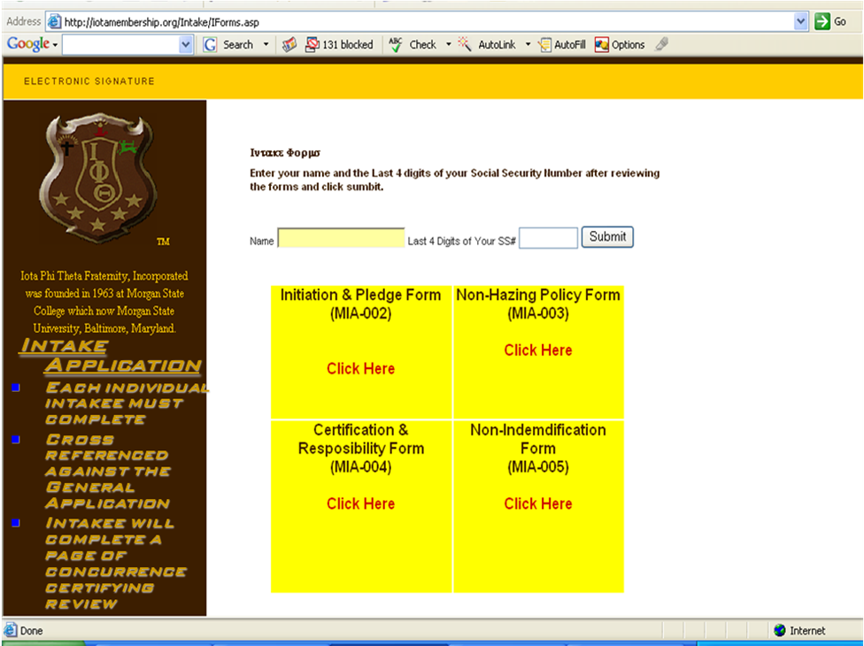
Have your initiates review the Initiation & Pledge, Non-Hazing Policy, Certification & Responsibility, and Non-Indemnification Form.
Once they have reviewed and understand the forms, have them enter their last name and last four of their SSN and click submit.
Notes:
Have your initiates review the Initiation & Pledge, Non-Hazing Policy, Certification & Responsibility, and Non-Indemnification Form. Once they have reviewed and understand the forms, have them enter the last name and last four of their SSN and click submit.

Slide 21
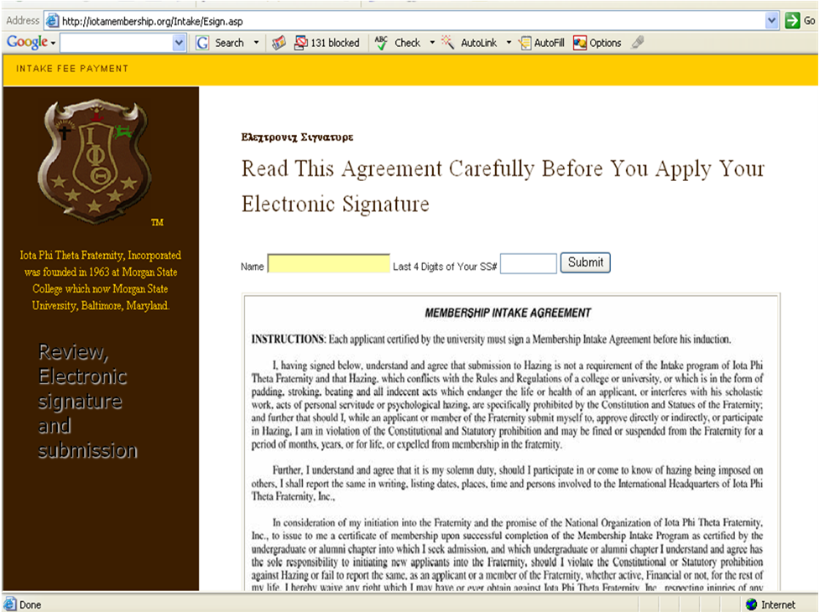
Have your initiates review the membership intake agreement.
Once they have reviewed and understand the form, have them enter the last name and last four of their SSN and click submit.
Notes:
Have your initiates review the membership intake agreement. Once they have reviewed
and understand the form, have them enter the last name and last four of their SSN and click submit.

Slide 22
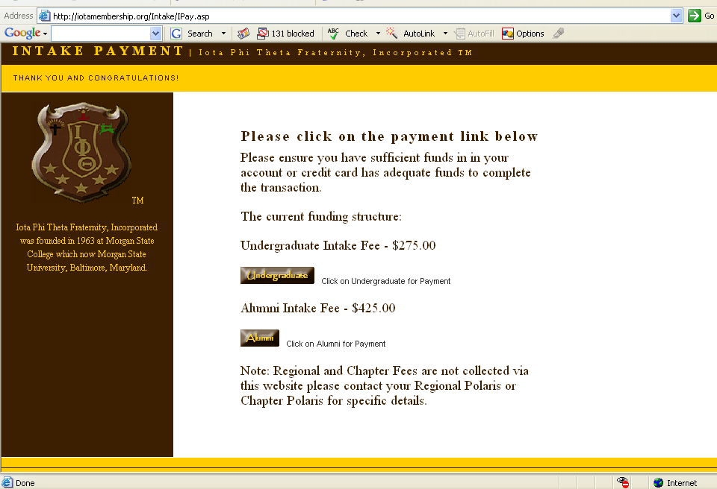
Notes:
For the fifth page, if they are an undergraduate initiate, the national fee is 275. If they are an alumni initiate, the national fee is 425. Have them click their respective button to be taken to the national paypal link (which is a secure electronic transaction)
Regional fees (which we currently DO NOT collect) and chapter fees are NOT collected via this website. Chapters are responsible for collecting their own fees -- chapter fee amounts must be submitted to the state director for his records. In the future (no later than the end of 2009), there will likely be policies in which further restrict amounts collected at the regional or local level.
National intake fees will increase this summer and will likely take effect for Fall 2008 intake. If there are updates on this policy change, it will be discussed as a part of this meeting or the Summer Conference,
Paypal transactions are the current business model for the fraternity. If you do not like doing business that way, then strongly suggest you develop an alternative policy proposal to bring before the regional and/or national bodies for deliberation at a future business meeting. In the interim, I strongly suggest that each chapter consider establishing a chapter paypal account which can be tied directly to the chapter bank account (all you need are the signature authorities, routing number, and account number) and used for all fraternity related payments (to include dues assessments, intake fees, regional function, etc). Setup takes less than 24 hours – for chapters that are interested we will discuss how to set up as part of the member intake certification class at the regional.

Slide 23
A Technique –
“Ceremonies”
REHEARSALS, REHEARSALS, REHEARSALS!
Bad Trend: 1st Time Looking At Ceremony Guide is at the Ceremony
Invest in a “Chapter Ceremony Kit”: Blindfolds (Hoodwinks), Paddles, Candles, Wooden Shield, etc.
Professionalism is essential
Appropriately attired (Brothers, Intakes: shirts & ties), sober, and respectful!
Way Ahead: Intake Manual and Pocket Ceremony Guide (Target Date: Summer Conference 2010)
Notes:
MATERIALS NEEDED
Table for Altar (with white tablecloth for cover)
Large Iota Shield (full color)
Sacred Cup (Evian water for beverage)
Sacred Paddle
Lectern or Reading Stand
Five (5) Gold Candles
One (1) Red Candle
Appropriate Candle Holders

Slide 24
Post-Intake
“…It Takes a Short Time to Pledge,
but a Lifetime to be a Brother…”
Attendance at a Regional & National Meeting (membership cards)
Line History & Updated Chapter History to Regional & Grand Historian
Receipt of Neophyte Member Items [handbook(s), membership certificate, lapel pin, chapter “P”, etc.]
Adherence to neophyte training requirements as identified by the chapter and/or region

Slide 25
Responsibilities
BROTHERS
All conducting intake must be financial and in good standing
All monies and electronic documents submitted promptly (before ANY intake activities begin)
Conduct quality control and pre-intake certification with Regional Polari
Report any violations of Fraternity (Hazing, Conduct) policies
Maintain contact with Regional Officers
Recruit “Quality” Brothers with potential of lifetime service to the fraternity
INTAKEES
All monies and electronic documents submitted promptly (before ANY intake activities begin)
Prepared to dedicate time and resources
Report any violations of fraternity (Hazing) policy
Talk with spouse(s) / significant other(s) about decision to initiate

Slide 26
Risk Management, Legal Liability, and Personal Accountability
“A Triangle of Responsibility”

Slide 27
Conversation Parameters
Can’t change international policies here….
Appropriate forum is proposal presentations and voting at a Conclave
Must comply with Federal, State, and Local Laws.
Can’t serve alcohol to minors (under 21): Federal
Hazing is a crime – state laws and university regulations

Slide 28
What is Risk Management (RM)?
Often, we think RM is about policies, rules, and things we CAN’T do
However, RM is about what we can do – the process of taking smart steps to avoid exposures
Focus and management of the risks that exist in an organization by virtue of the existence of the organization and its unique characteristics

Slide 29
Risk Management (RM) stated another way….
The ability of an organization to recognize potential events that are likely to place the assets, integrity and credibility of an organization in jeopardy
The ability to identify those potential events, monitor them and prevent them from jeopardizing the assets, integrity and credibility of the organization
In fraternity and sororities, a major component of risk management is hazing!
Good Resource: http://www.stophazing.org/

Slide 30
What does Risk Management Involve?
Event Planning
Risk Reduction/Transfer
Education
Insurance

Slide 31
Why do we have Risk Management?
Protect assets:
People are our most important asset; and
Resources (money, property, real estate, etc) allows the Fraternity to function effectively

Slide 32
Components of Our Risk Management Policy
Hazing
Know fraternity, campus, local, and state policies; highest standard prevails
Sexual Harassment/Abuse/Discrimination
Includes date/gang rape and verbal harassment
Contractual and Financial
Chapters cannot enter into financial agreements using the specific name of Iota Phi Theta
Alcohol and Drugs (Substance Abuse)
Know fraternity, campus, local, and state policies; highest standard prevails
Notes:
Risk Management Policy
WHEREAS, Iota Phi Theta unequivocally supports a legal, responsible and safe lifestyle for fraternity members;
WHEREAS, Iota Phi Theta has previously taken a strong stance and positive action against hazing, substance abuse and discrimination;
WHEREAS, Iota Phi Theta is dedicated to a quality fraternity experience and therefore encourages college administrators, other campus organizations, and each local chapter to adopt and implement a Risk Management Policy to provide for a legal, responsible and safe campus life;
WHEREAS, Iota Phi Theta has consistently recognized and supported the ability of individual chapters to govern themselves;
BE IT RESOLVED, that Iota Phi Theta encourages the development, implementation and maintenance of a Risk Management Policy by each individual chapter in accordance with federal, state, local, campus and fraternity laws and regulations.
BE IT FURTHER RESOLVED, that Iota Phi Theta will work with university and college administrators and faculty, other interested campus organizations, and chapters to implement and insure compliance with this policy.
HAZING No fraternity member shall take part in hazing activities. Hazing activities are defined as (but not limited to):
Any action taken or situation created, intentionally, whether on or off fraternity premises or during fraternity functions, to produce mental or physical discomfort, embarrassment, harassment, or ridicule. Such activities may include but are not limited to the following: use of alcoholic beverages; paddling in any form; branding; creation of excessive fatigue, physical or psychological shocks; quests; treasure hunts; scavenger hunts, road trips; or any other such activities carried on in the name of the fraternity; wearing of public apparel which is conspicuous and not normally in good taste; engaging in public stunts and buffoonery; morally degrading or humiliating games and activities; and any other activities which are not consistent with fraternal law, ritual or policy or the regulations and policies of the educational institution and local, state and federal laws.
SEXUAL HARASSMENT / ABUSE DISCRIMINATION The fraternity will not tolerate or condone any form of abusive or discriminatory behavior on the part of its members, whether physical, mental or emotional in respect to sex, race, ethnicity, physical or emotional handicap, age, marital status or sexual preference. This is to include any actions that are deemed demeaning to all but not limited to date/gang rape or verbal harassment.
CONTRACTUAL and FINANCIAL ISSUES No chapter or region may enter into a contract or financial agreements using the specific name of Iota Phi Theta. Qualifying statements as to which chapter or region must accompany all agreement entered into for the purposes of supporting fraternity functions. This includes, but is not limited to, such agreements as leases, contracts, hold harmless agreements, liability releases, account agreements, purchase orders, and hotel or banquet contracts.
ALCOHOL and DRUGS (SUBSTANCE ABUSE) The possession, use and/or consumption of Alcoholic Beverages, during any fraternity event, any event that an observer would associate with the fraternity, or in any situation sponsored or endorsed by the chapter, must be in compliance with any and all applicable laws, policies and regulations of the state, county, city and institution of higher education.
The unlawful possession, sale and/or use of any illegal drugs or controlled substances at any fraternity sponsored event, or at any event that an observer would associate with the fraternity, is strictly prohibited.
Chapters, Interest Groups and Petitioning Groups of Iota Phi Theta shall not use or condone the use of alcoholic beverages as part of their membership intake recruitment or education programs. A violation of this policy shall be deemed a violation of the membership policies of Iota Phi Theta National Service Fraternity.

Slide 33
Components of Our Risk Management Policy, con’t
Personal Property
Use in fraternity activities strictly voluntary & sole responsibility of the owner
Transportation Issues
Operate in accordance with (IAW) rental contract and local municipality rules
General Health and Safety
Use Personal Protective Equipment (PPE) that is appropriate for said activity
Advisors
Operate IAW policies of university or community organization that emplaces them as advisors
Education
Fraternity members train and certify on membership intake, crisis management, and risk management annually
Notes:
PERSONAL PROPERTY Use of personal property in fraternity activities shall be strictly voluntary and the sole responsibility of the owner. Iota Phi Theta shall not assume liability for personal property used in conjunction with fraternity activities, nor for any damages resulting from said use.
TRANSPORTATION ISSUES Any individual who drives or otherwise provides transportation in conjunction with Iota Phi Theta activities shall obey all applicable motor vehicle laws, including, but not limited to, those concerning vehicle safety, vehicle operation, insurance, and the transportation and consumption of alcoholic beverages. Operators will ensure that vehicles are not overloaded and are driven in a safe manner. Rental vehicles shall be operated in accordance with rental contracts.
GENERAL HEALTH AND SAFETY All activities planned in conjunction with Iota Phi Theta shall take into account the health and safety of all participants.
Planning of Iota Phi Theta projects and activities will include appropriate personal safety equipment (ear plugs, eye protection, gloves, etc.), training (use of tools and equipment), and supervision. All equipment to be used in conjunction with Iota Phi Theta activities will be in good working condition and will be used in a safe manner.
ADVISORS Advisors and alumni serving Iota Phi Theta on behalf of their employer or respective volunteer agency (educational institution, youth service organization, etc.) will do so in accordance with the policies of said entity, including but not limited to risk management and personal liability"
Advisors and alumni shall adhere to the provisions of this and all applicable policies of the fraternity when engaging in fraternity-related activities.
Advisors and alumni shall recognize the appropriate authority of elected or appointed officers, representatives or employees of the fraternity in questions of policy, and shall not engage in activities designed to circumvent fraternity policies.
EDUCATION All reasonable efforts will be made to insure each student member, pledge, associate member, advisor, and honorary member shall be instructed on the Risk Management Policies annually.
Active chapters will indicate their understanding of and compliance with the Risk Management Policy statement on an annual basis.
Organizers of fraternity events will reasonably inform guests (including non-members, alumni, advisors and visiting members) of applicable policies.

Slide 34
What is Hazing?
Hazing activities are defined as (but not limited to): Any action taken or situation created, intentionally, whether on or off fraternity premises or during fraternity functions, to produce mental or physical discomfort, embarrassment, harassment, or ridicule. Such activities may include but are not limited to the following: use of alcoholic beverages; paddling in any form; branding; creation of excessive fatigue, physical or psychological shocks; quests; treasure hunts; scavenger hunts, road trips; or any other such activities carried on in the name of the fraternity; wearing of public apparel which is conspicuous and not normally in good taste; engaging in public stunts and buffoonery; morally degrading or humiliating games and activities; and any other activities which are not consistent with fraternal law, ritual or policy or the regulations and policies of the educational institution and local, state and federal laws.
Bottom Line: The legal definition covers a wide variety of ground. Stay current with National and University Risk Management Policies

Slide 35
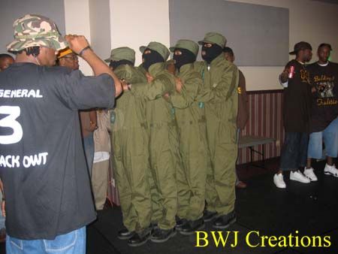
Common definition of hazing
“Hazing” refers to any activity expected of someone joining a group (or to maintain full status in a group) that humiliates, degrades or risks emotional and/or physical harm, regardless of the person's willingness to participate.

Slide 36
Anti-Hazing Laws
Anti-Hazing laws are laws that criminalize hazing behavior; or
laws that make it easier to sue or impose civil liability on a person or entity who engages or members engage in hazing behavior.
44 States Have Anti-Hazing Laws
The 6 States Who Don’t: Alaska, Montana, South Dakota, Hawaii, New Mexico, Wyoming

Slide 37
ANTI-HAZING LAWS
OF
SELECTED STATES IN YOUR REGION
Notes:
Regional Training Coordinators may go into depth regarding hazing laws and incidents within their respective regions.

Slide 38
Michigan Hazing Law THE MICHIGAN PENAL CODE (EXCERPT)

Slide 39
(6) It is not a defense to a prosecution for a crime under this section that the individual against whom the hazing was directed consented to or acquiesced in the hazing. (7) As used in this section: (a) “Educational institution” means a public or private school that is a middle school, junior high school, high school, vocational school, college, or university located in this state. (b) “Hazing” means an intentional, knowing, or reckless act by a person acting alone or acting with others that is directed against an individual and that the person knew or should have known endangers the physical health or safety of the individual, and that is done for the purpose of pledging, being initiated into, affiliating with, participating in, holding office in, or maintaining membership in any organization.
Subject to subsection (5), hazing includes any of the following that is done for such a purpose: (i) Physical brutality, such as whipping, beating, striking, branding, electronic shocking, placing of a harmful substance on the body, or similar activity. (ii) Physical activity, such as sleep deprivation, exposure to the elements, confinement in a small space, or calisthenics, that subjects the other person to an unreasonable risk of harm or that adversely affects the physical health or safety of the individual. (iii) Activity involving consumption of a food, liquid, alcoholic beverage, liquor, drug, or other substance that subjects the individual to an unreasonable risk of harm or that adversely affects the physical health or safety of the individual. (iv) Activity that induces, causes, or requires an individual to perform a duty or task that involves the commission of a crime or an act of hazing. (c) “Organization” means a fraternity, sorority, association, corporation, order, society, corps, cooperative, club, service group, social group, athletic team, or similar group whose members are primarily students at an educational institution. (d) “Pledge” means an individual who has been accepted by, is considering an offer of membership from, or is in the process of qualifying for membership in any organization. (e) “Pledging” means any action or activity related to becoming a member of an organization. (f) “Serious impairment of a body function” means that term as defined in section 479a. (8) This section shall be known and may be cited as “Garret's law.”
Act 328 of 1931
750.411t.added Hazing prohibited; violation; penalty; exceptions; certain defenses barred; definitions; section title. Sec. 411t. (1) Except as provided in subsection (4), a person who attends, is employed by, or is a volunteer of an educational institution shall not engage in or participate in the hazing of an individual. (2) A person who violates subsection (1) is guilty of a crime punishable as follows: (a) If the violation results in physical injury, the person is guilty of a misdemeanor punishable by imprisonment for not more than 93 days or a fine of not more than $1,000.00, or both. (b) If the violation results in serious impairment of a body function, the person is guilty of a felony punishable by imprisonment for not more than 5 years or a fine of not more than $2,500.00, or both. (c) If the violation results in death, the person is guilty of a felony punishable by imprisonment for not more than 15 years or a fine of not more than $10,000.00, or both. (3) A criminal penalty provided for under this section may be imposed in addition to any penalty that may be imposed for any other criminal offense arising from the same conduct. (4) This section does not apply to an individual who is the subject of the hazing, regardless of whether the individual voluntarily allowed himself or herself to be hazed. (5) This section does not apply to an activity that is normal and customary in an athletic, physical education, military training, or similar program sanctioned by the educational institution.

Slide 40
Ohio Hazing Law

Slide 41
The State of Ohio's Hazing Law is set forth in Section 2307.44 of the Ohio Revised Code. Any person who is subjected to hazing, as defined in division (A) of Section 2903.31 of the Revise Code, may commence a civil action for injury or damages, including mental and physical pain and suffering, that result from the hazing. The action may be brought against any participants in the hazing, any organization whose local or national directors, trustees, or officers authorized, requested, commanded, or tolerated the hazing. If the hazing involves students in a primary, secondary, or post-secondary school, university, college, or any other educational institution, an action may also be brought against any administrator, employee, or faculty member of the school, university, college, or other educational institution. If an administrator, employee, or faculty member is found liable in a civil action for hazing, then notwithstanding Chapter 2743. of the Revised Code, the school, university, college, or other educational institution that employed the administrator, employee, or faculty member may also be held liable. The negligence or consent of the plaintiff or any assumption of the risk by the plaintiff is not a defense to an action brought pursuant to this section. In an action against a school, university, college, or other educational institution, it is an affirmative defense that the school, university, college or other institution was actively enforcing a policy against hazing at the time the cause of action arose.
Section 2903.31 (A)As used in this section, "hazing" means doing any act or coercing another, including the victim, to do any act of initiation into any student or other organization that causes or creates a substantial risk of causing mental or physical harm to any person. (B)(1)No person shall recklessly participate in the hazing of another. (2)No administrator, employee, or faculty member of any primary, secondary, or post-secondary school or of any other educational institution, public or private, shall recklessly permit the hazing of any person. (C)No administrator, employee, or faculty member of any primary, secondary, or post-secondary school or of any other educational institution, public or private, shall recklessly permit the hazing of any person.

Slide 42
Negligence
Components of Negligence:
Duty
Example: Not provide alcohol to minors
Failure to perform duty
Alcohol provided to minor
Injury resulting from failure to perform duty
Minor gets alcohol poisoning

Slide 43
Claims
Over 90% of claims involve alcohol
Risky behaviors that leave us most vulnerable to insurance claims
Hazing
Alcohol
After-effects
Higher insurance rates
Insurance Policy Changes (more/different rules)
More external (school/community) and internal (fraternity) scrutiny

Slide 44
Examples of Claims
FACTS
Fraternity members fired a potato gun which struck the eye of a student
Student filed suit against members
Individuals (including person that loaded gun, person that fired gun, person that supplied the potato, and person that held gun) were found liable
Payout: $500,000 combined
How much money did YOUR chapter bring in to IOTA this year?

Slide 45
Examples of Claims
FACTS
Seventeen year old girl served alcohol at chapter party.
Girl struck by drunk driver and killed after leaving party.
Girl had Blood Alcohol Content (BAC) between .08 and .10
Payout: $150,000 settlement + over $9,000 attorney fees
How much money did YOUR chapter bring in to IOTA this year?

Slide 46
Examples of Claims
FACTS
Member died in chapter house after drinking alcohol following induction ceremony.
Alcohol was supplied by the member’s big brother.
Member’s parent’s sued the fraternity.
After over two years of litigation, fraternity was found not liable.
Payout: $200,000 in attorney fees and other expense
How much money did YOUR chapter bring in to IOTA this year?
Bottom line: we CANNOT afford a lawsuit!

Slide 47
Tools that need to be in place to Support Change
Consistent Policies
Education
Enforcement Mechanisms with due process
Accountability

Slide 48
Crisis Management
Examples of such situations include, but are not limited to:
death or serious illness injury of a member, guest or membership intake participant;
fire in the chapter House and or Fraternity Sponsored Event or other property;
an injury or accident involving alcohol at social events;
an injury or accident involving a member and/or a non-member at or during a chapter event or on chapter property;
the arrest of an initiated member.
Bottom Line
Use your chain of command immediately
Bad News Doesn’t Get Better with Age

Slide 49
Crisis Management Procedures
Establish the chain of command
Chapter Polaris (or next senior chapter officer) take charge
Undergraduate Chapters: Immediately consult your Chapter Advisor (financial member of neighboring alumni chapter)
Seal and Control the Area
Only chapter officers, advisors, and university officials should enter and leave until instructed otherwise by authorities
Emergency Calls (in order)
911, University officials (if undergrad chapter), Chapter Advisor, State Director (who will contact ARP/RP)
If you cannot reach anyone in chain, contact ARP/RP immediately
In consultation with regional and national office, communicate with outside agencies
When in doubt call your State Director, ARP, or RP immediately…Bad News Doesn’t Get Better with Age
Notes:
Establish a round robin starting with the polaris, ending with the polaris. Polaris calls VP, VP calls Sec, Sec call Treasury, then brotherhood. Lasr brother alphabetically call the polaris back. Polaris knows that the chain was passed. Polaris alerts the ARP, and grad advisor.

Slide 50
CONCLUSION
Three annual components of training: Intake Programming, Crisis Management, and Risk Management
Intent to produce brothers able to immediately move into positions of fraternal responsibility
Revising program to reflect membership requirements change
Membership Development (Training and Education): Life Long Process

